Slide 2
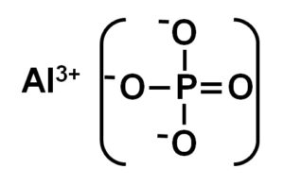
aluminum phosphide poisoning

Slide 3
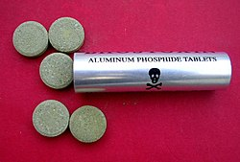

Slide 7
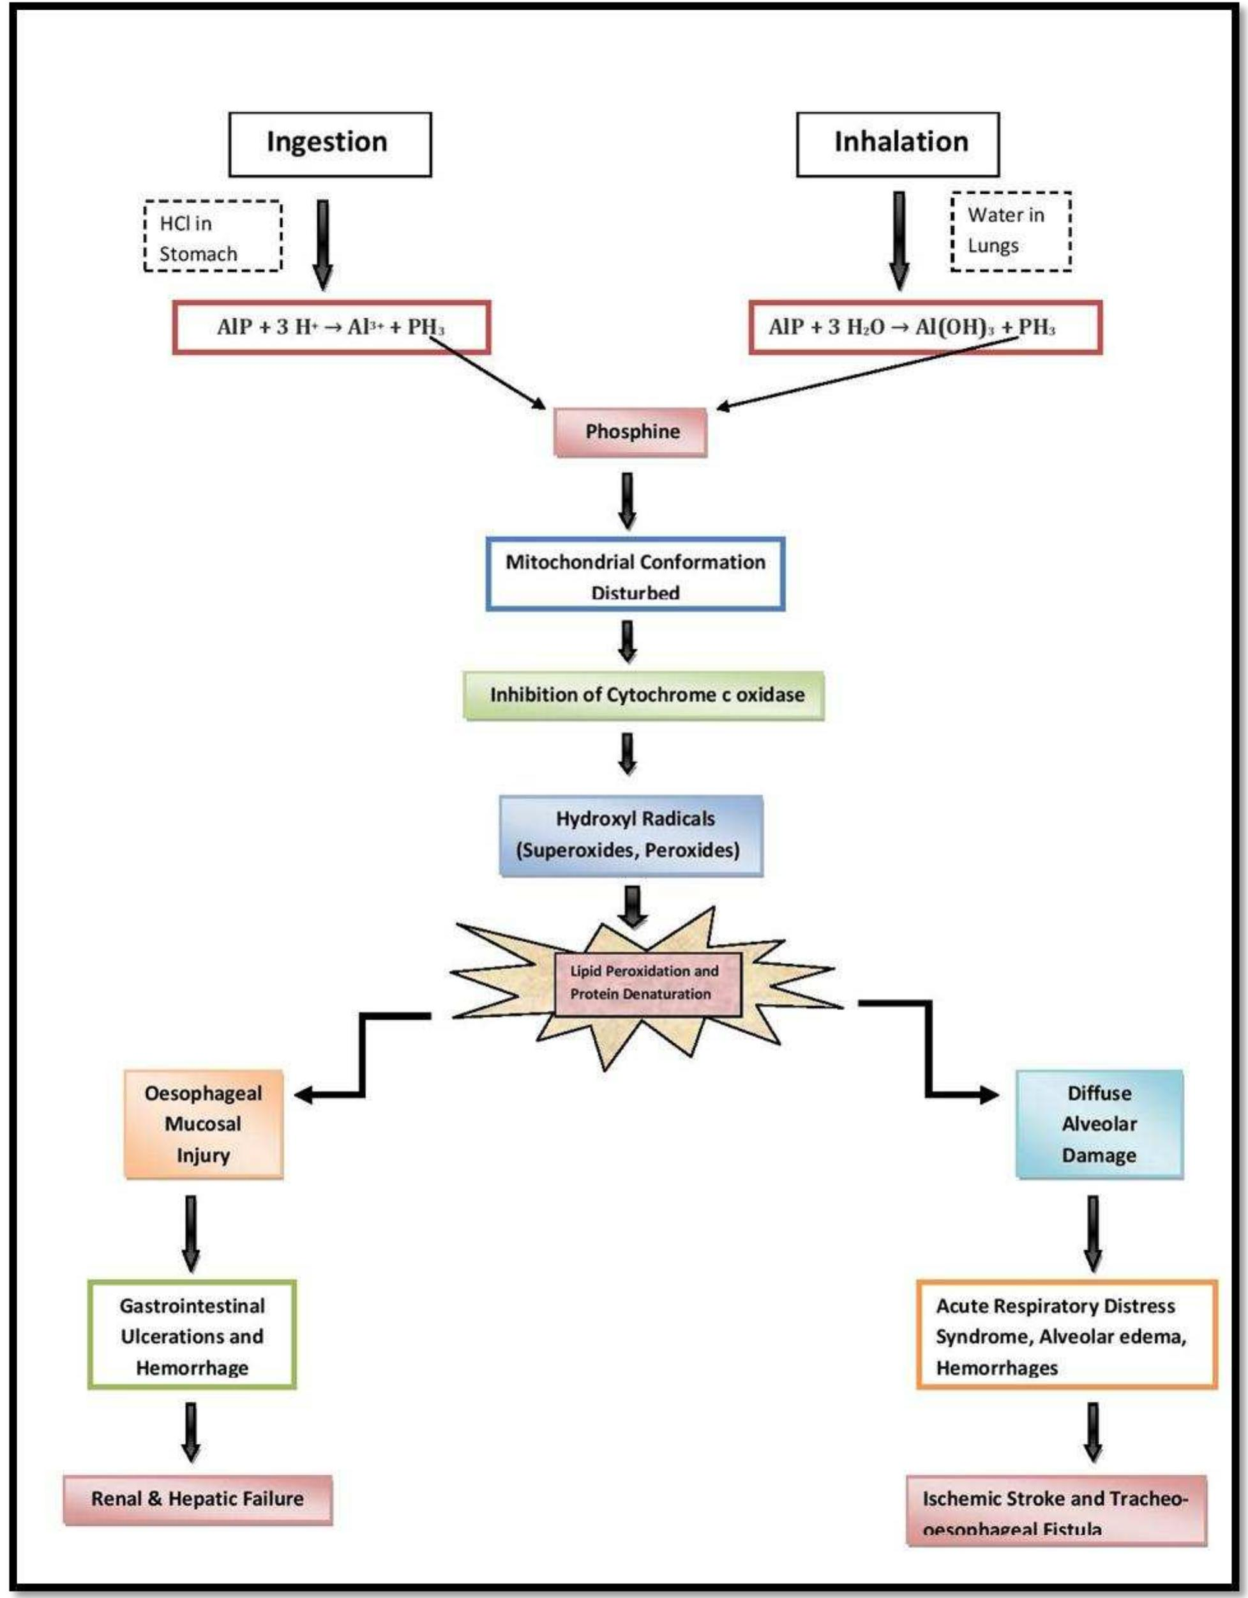

Slide 8
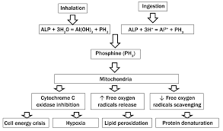

Slide 9
cellular hypoxia due to the effect on mitochondria, inhibition of cytochrome C oxidase and formation of highly reactive hydroxyl radicals

Slide 10
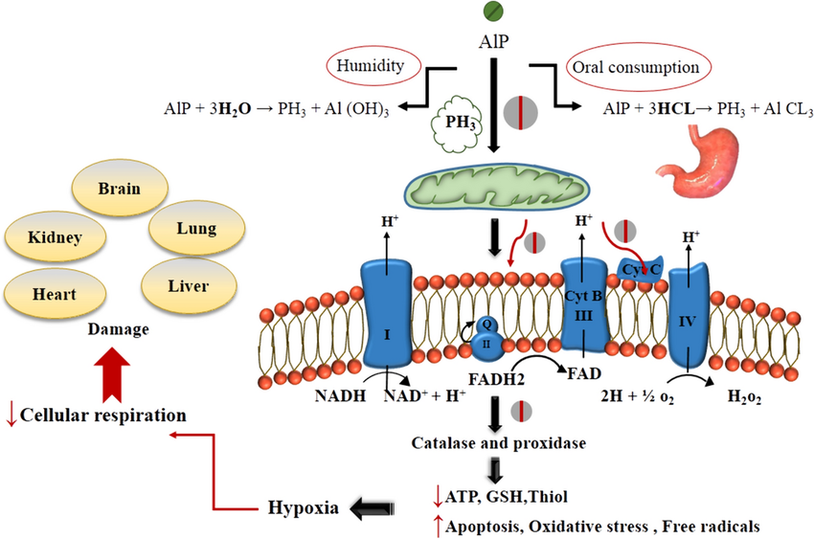

Slide 11
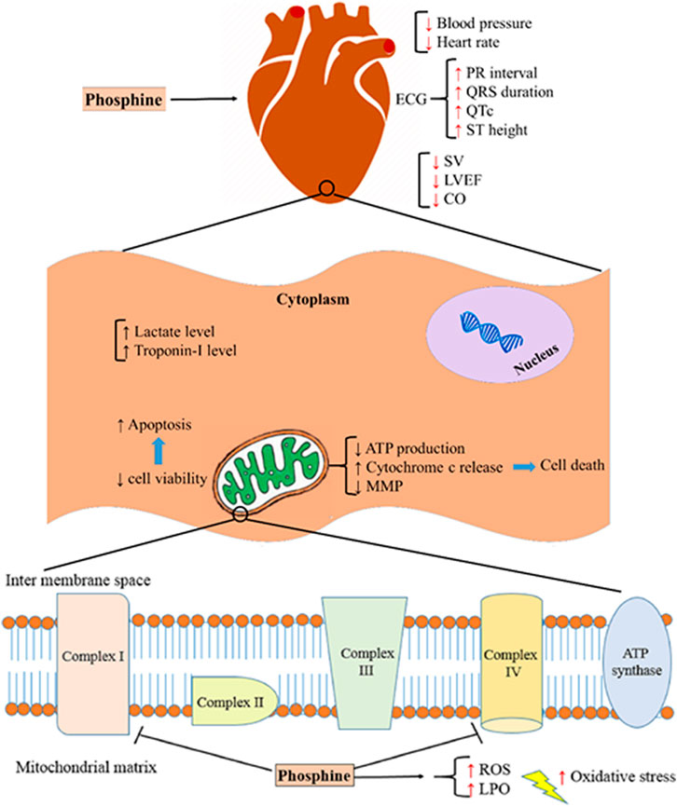

Slide 12
Lethal dose of ALP is 1-1.5 g. Deaths are reported even with a dose of 150-500 mg

Slide 13
Aluminum Phosphide Poisoning Mortality Rate in Iran; a Systematic Review and Meta-Analysis
21 studies with 3432 cases of ALP poisoning were included in this meta-analysis. The mortality rate of ALP poisoning in Iran was 39.6%,. Morality rate in male and female patients was 62.3% and 27.7%.

Slide 14
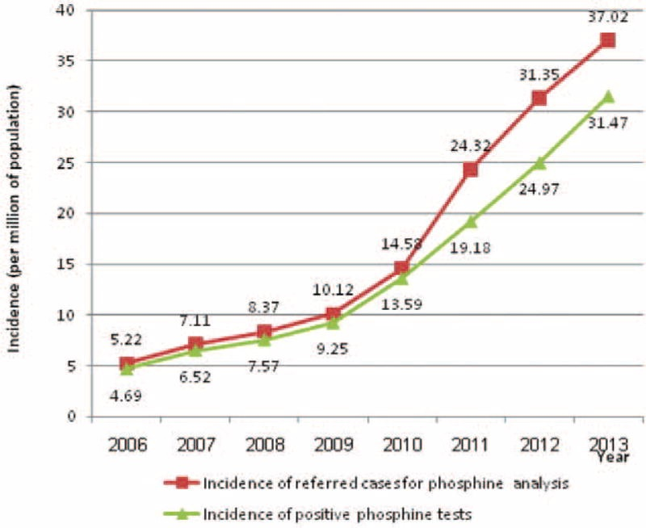

Slide 15
